Slide 1
Advantages of a Bear
Market
Yes there is a positive side to a Bear Market!

Slide 2
Investing in Stocks
Represents ownership
in a firm
Earn a return in
two ways
  Price of the stock rises
  over time
  Dividends are paid to the stockholder
Stockholders have claim on all assets
Right to vote for directors and on certain issues
Two types
  Common stock
    Right to vote
    Receive dividends
  Preferred stock
    Receive a fixed dividend
    Do not usually vote
Copyright © 2006 Pearson Addison-Wesley. All rights reserved.
11-<number>

Slide 3

Investing in Stocks:
Sample Corporate Stock Certificate
Figure 11.1 Wien Consolidated Airlines Stock
11-<number>

Slide 4
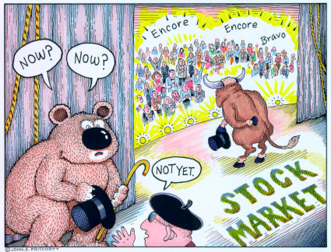
What is a Bear Market?
A decline of 15-20% of the broad market coupled with pessimistic sentiment underlying the stock market.

Slide 5
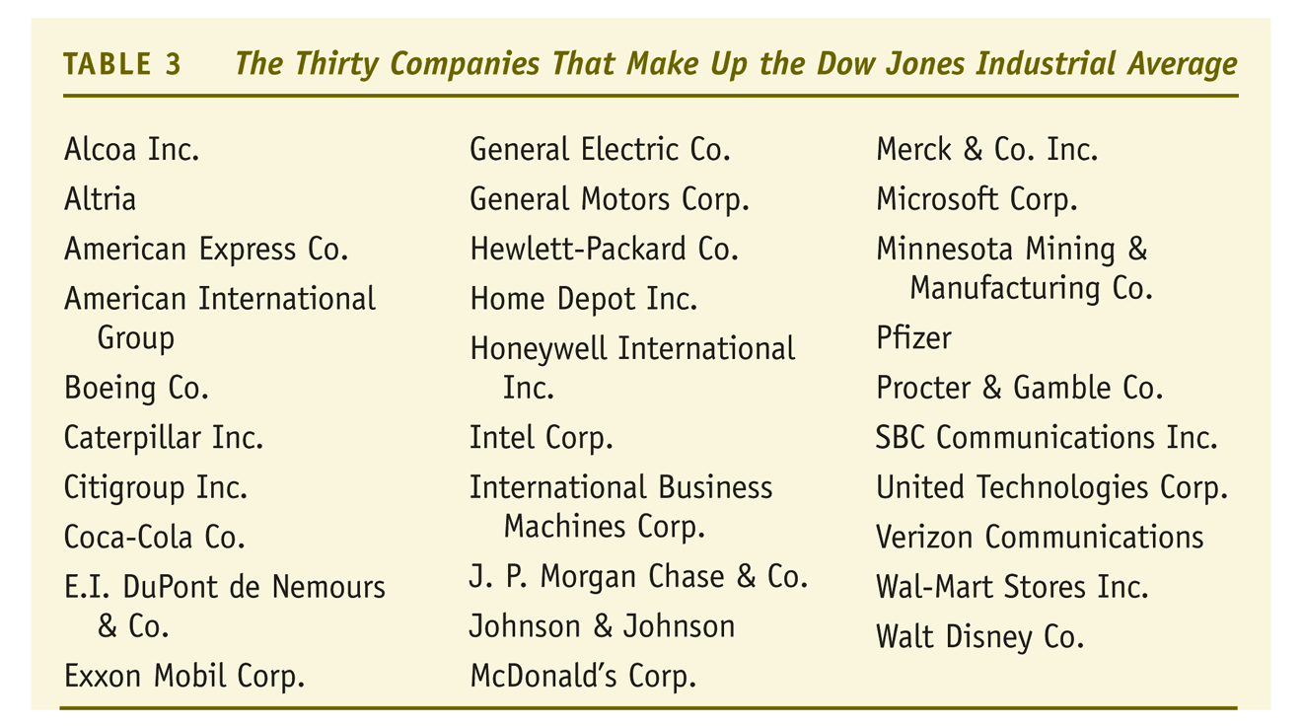
Stock Market Indexes: the Dow Jones Industrial Average
11-<number>

Slide 6
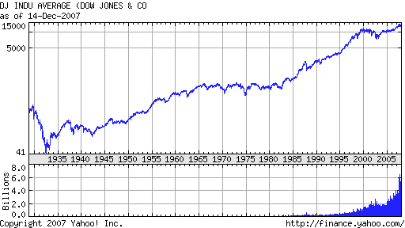
Dow Jones

Slide 7
The last Bear market
Sept. 30, 2002 Dow 7528
Jan. 5, 2004 Dow 10,568
Oct. 8, 2007 Dow 14093

Slide 8
What do I do in a Bear Market
Decide whether this is a market correction or the start of something more
Review the stocks you own
Review stocks you wanted to own but were too expensive at time of research
Check your portfolio for balance or the type of stocks you own

Slide 9
Things you Don’t want to do in a Bear Market
Do not panic sell
Do not buy stocks just because they are cheap
Do not buy because the media says it is a good time or a cheap price
Do not sell stocks short unless you understand how to do it and what could happen

Slide 10
Do’s in a Bear Market
Stay the course
Review why you bought the stocks in the first place and decide if anything has changed
Dollar cost average your stocks
Review quality stocks that were over priced
Review your SSGs for buying signals
Remember that when stocks are on sale you get more “bang for your buck”
Sell losers to offset capital gains and buy them back in 31 days if it is still a buy

Slide 11
Buy Low and Sell High
Better Investing(NAIC) and Warren Buffet guidelines: buying good quality companies with good fundamentals at a fair or bargain price with more room for growth and price appreciation.

Slide 12
Advantages of a Bear Market
There are only 2 times when it matters what price a stock sells for
1. When you buy it
2. When you sell it

Slide 13
Review
Don’t panic sell
Don’t buy just because prices are low or the media recommends you buy
Learn from your mistakes
Review your SSG’s and your portfolio
Remember that a bear market is a buying opportunity
Don’t forget about your tax situation

